Slide 1
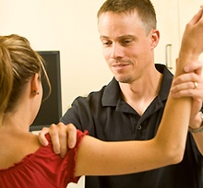
HOPS

Slide 2
HOPS
How many have taken a forensics class? Or does anyone have any interest in forensics?
How many enjoy crime shows?

Slide 3
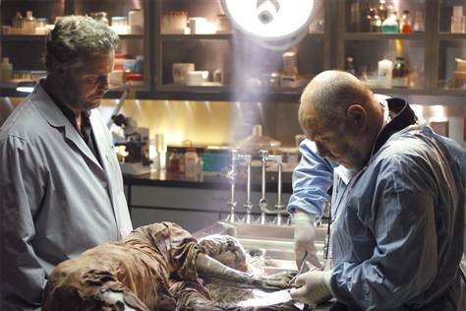
HOPS
Think about the importance of each piece of evidence at a crime scene and share the answers to the following questions with a partner:
1. What would happen if one part of the investigation was left out?
2. Why is it important to have all of the pieces in order to see the whole picture?
After discussing the answers with your partner, be prepared to share with the rest of the class.

Slide 4
HOPS
Not all evidence is intriguing to study

Slide 5
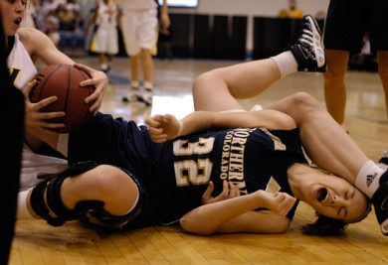
HOPS : Vocabulary
Etiology The cause of an injury or a disease

Slide 6
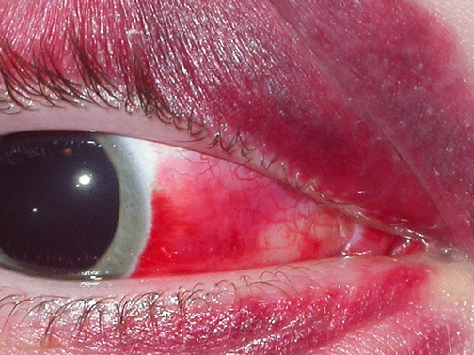
HOPS Vocabulary
Pathology the changes that occur as a result of an injury

Slide 7
HOPS Vocabulary
Mechanism How the injury occurred

Slide 8
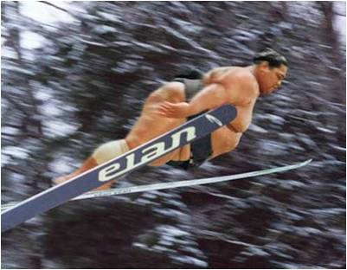
HOPS Vocabulary
Acute
An injury with a sudden occurrence

Slide 9
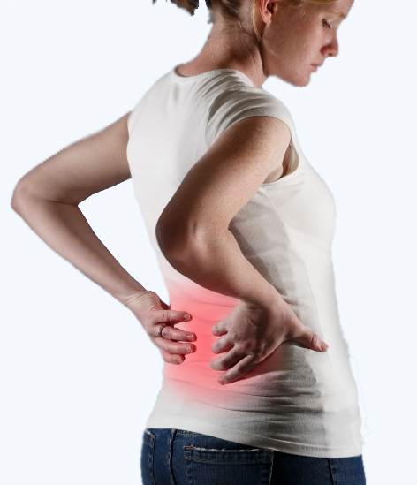
HOPS Vocabulary
Chronic
A recurring injury; one that has been going on for an extended period of time

Slide 10
HOPS History
To establish the history, use the MAPPS pneumonic:
M = Mechanism of injury
A = Acute or chronic
P = Previous history of injury
P = Pain (type & location)
S = Sounds heard or felt at the time of injury or since

Slide 11
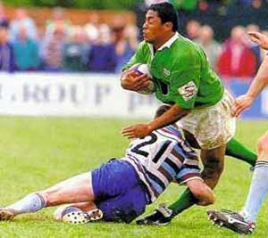
HOPS Mechanism
Sample questions:
How did the injury occur?
What caused the injury?
What happened?
Were you able to continue participating?
Can you think of any other questions you might ask?

Slide 12
HOPS Acute / Chronic
Acute or Chronic
Sample Questions:
When did the injury happen?
Has the injury been going on for a while?
If so, for how long?
Can you think of any other questions you might ask?

Slide 13
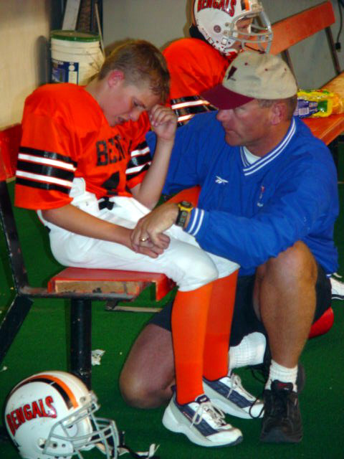
HOPS Previous History
Sample Questions:
Has this ever happened before?
If so, when did it happen?
What was done to care for the injury?
Can you think of any other questions you might ask?

Slide 14
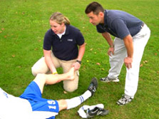
HOPS Pain
Sample Questions:
Where was the pain initially?
Where does it hurt now?
What relieves the pain?
What makes the pain worse?

Slide 15
HOPS Pain
Sample Questions:
Describe the pain.
On a scale of 1 to 10, how severe is the pain?
What have you done to relieve the pain?
Can you think of any other questions you might ask?

Slide 16
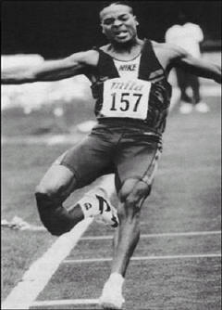
HOPS Sounds
Sample Questions:
What did you hear?
What did you feel?
Can you think of any other questions you might ask?

Slide 17
HOPS Observation
Compare the uninvolved side with the involved side

Slide 18
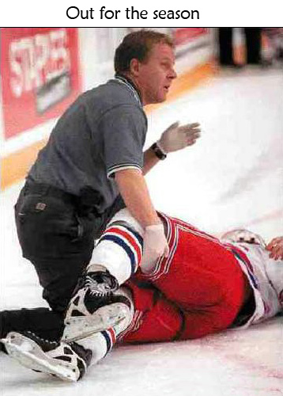
HOPS Observation
Look for:
Swelling
Deformity / dislocation
Discoloration
Bleeding
Break(s) in the skin

Slide 19
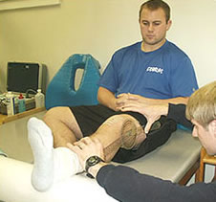
HOPS Observation
Compare the uninvolved side with the involved side
Look for:
Scars from previous surgeries
Muscle atrophy (decreased size)
Loss of movement

Slide 20
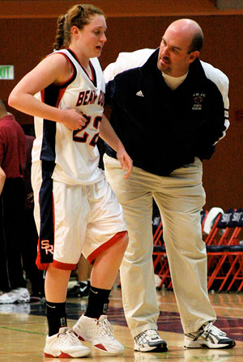
HOPS Observation
Look for:
Is the athlete limping?
Did the athlete need assistance to get up?
Is the athlete protecting the injured extremity?

Slide 21
Partner Assignment
Ask & answer at least FIVE different questions about an injury & make at least THREE observations EACH.
Get into a group of two.
Based on what we know about injuries so far, choose one to mimic & answer some questions about. Alternate turns being the evaluator & the patient.

